Slide 1
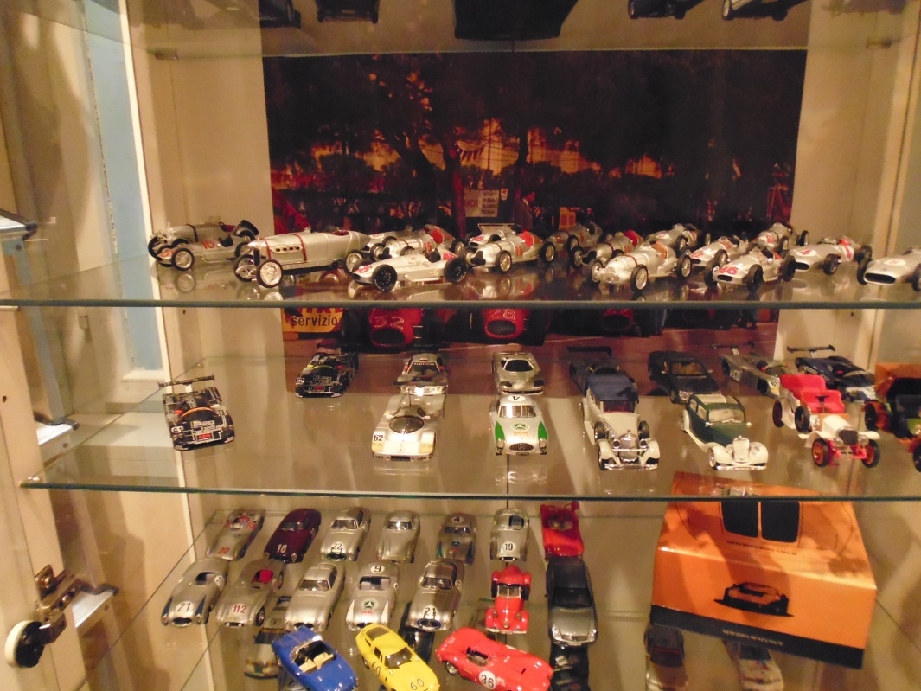
Motor-Mythos SHOP

